Slide 1
Flipkart CSAT & SLA Performance Analysis
Highlights:
30,001 calls analyzed across 4 call centers.
62.38% calls handled within SLA.
Average CSAT = 209.5
Positive Sentiment = 21.53%
Average Call Duration = 25 mins

Slide 2
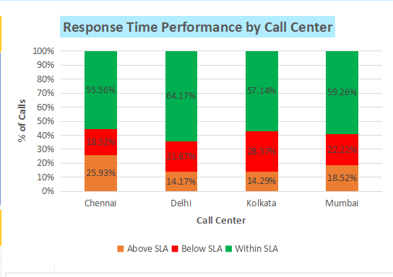
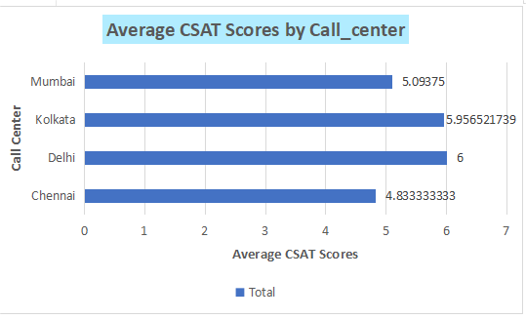
Service Performance by Call Center
Delhi performs best: 64.17% within SLA & highest CSAT (6.0).
Chennai underperforms: only 55.56% within SLA, lowest CSAT (4.83).
Longer response delays correlate with customer dissatisfaction.

Slide 3
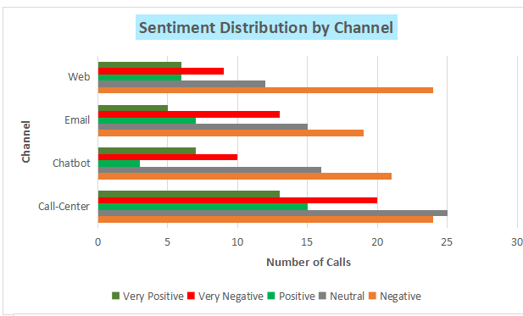
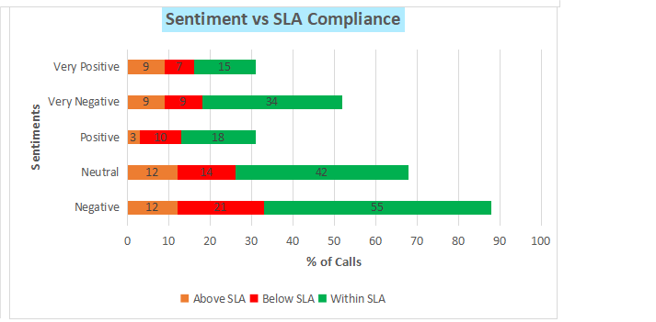
Sentiment Analysis Across Channels
Positive Sentiment = only 21.5% overall.
Call Center & Email have higher negative feedback.
Web & Chatbot channels show better neutral to positive balance.
Within SLA calls show higher positive sentiment compared to Below SLA calls.

Slide 4
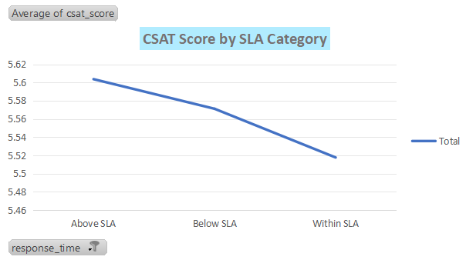
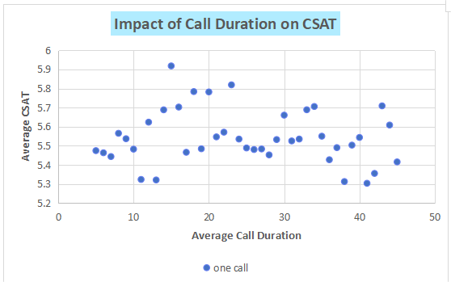
Drivers of Customer Satisfaction
Insights from Correlations:
Calls resolved within SLA have higher CSAT (~5.6–6.0).
Longer call durations (>30 mins) lower CSAT (~5.3–5.4).
Improving SLA compliance can increase CSAT by 15–20%.
Improvement Areas:
Train slow-performing centers (Chennai, Mumbai).
Introduce quick-resolution workflows & self-service options.

Slide 5
Business Impact & Recommendations
Expected Impact:
Raising SLA compliance from 62% → 80% may lift CSAT by ~20%.
Improving positive sentiment from 21% → 40% boosts retention by ~25%.
Efficient service reduces churn and increases repeat orders.
Key Recommendations:
Improve SLA tracking and reduce waiting time.
Train agents in empathy and proactive issue handling.
Use dashboards to monitor CSAT & sentiment weekly.

